Slide 1
VA Central IRB Site Liaison and
IRBNet Administrator Training
Don E. Workman, Ph.D., VA IRB Network Director
Christie O’Brien, VA Central IRB Manager
Lindsey Martin, VA Central IRB Program Specialist
Angela Foster, VAIRRS Program Manager
March 2, 2021
Dial in (Main): (404) 397-1596
Attendee Access Code: 199-698-9035
Slides available on SharePoint:
See link in Q&A Box

Slide 2
Topics
  CIRB SharePoint Site
  What is VAIRRS?
  Accessing and Registering in IRBNet
  CIRB Submission Process
  Additional Guidance and Support

Slide 3
What happens to SharePoint?
The CIRB SharePoint portal will be not accept new submissions after March 12th at 8 PM EST
SharePoint will remain as a reference and document storage until study documents are transferred to IRBNet
  Priority for study document upload will be given to pending actions and studies with an upcoming (on or before April 15th) continuing review/annual status report due date
All new actions must be submitted via IRBNet to the local research office
  Researchers affiliated with sites not yet active may submit directly to CIRB
  See end of presentation for the scheduled go-live dates for all sites not yet active on VAIRRS

Slide 4
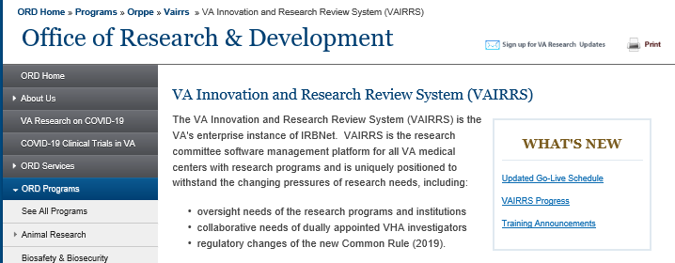
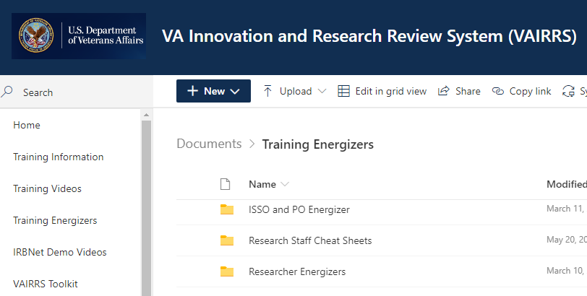
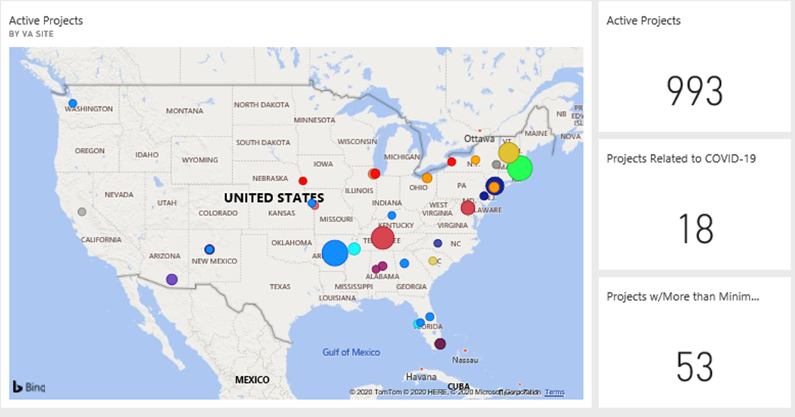
What is VAIRRS?
VA Innovation Research and Review System
  IRBNet
  VAIRRS Website: https://www.research.va.gov/programs/orppe/vairrs/default.cfm
  VAIRRS SharePoint Portal: https://dvagov.sharepoint.com/sites/VHAORPPE/vairrs
  PowerBI Dashboards

Slide 5
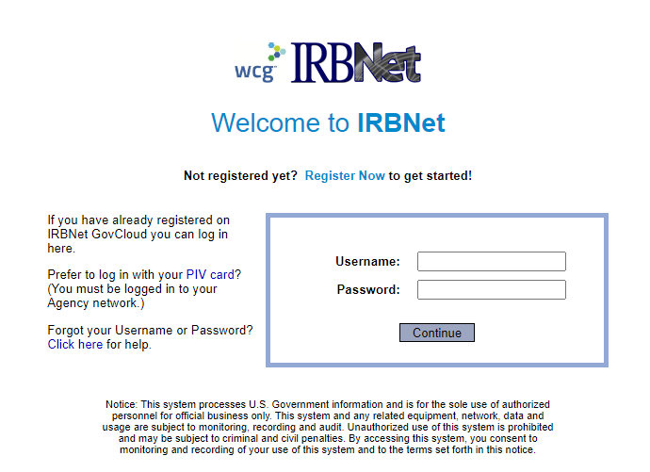
Accessing IRBNet
Website address: gov.irbnet.org
  PIV Login
  Accessible from outside the VA network

Slide 6
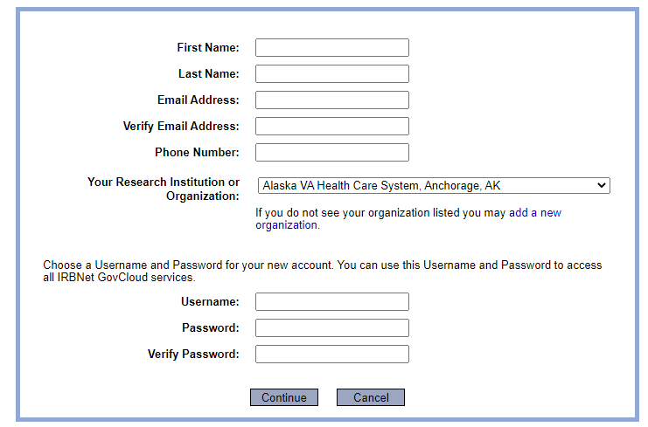
Enrolling in IRBNet
All VA facilities are listed in affiliation section

Slide 7

Important SOP Change
Board documents will no longer be posted to SharePoint as all information is available in IRBNet.

Slide 8

Polls
Have you registered for an IRBNet account yet?
  Yes
  No
If you have registered, are you actively using IRBNet?
  Not using at all
  Using at least once a month
  Using at least once a week
  Using daily

Slide 9
CIRB Submission Process

Slide 10
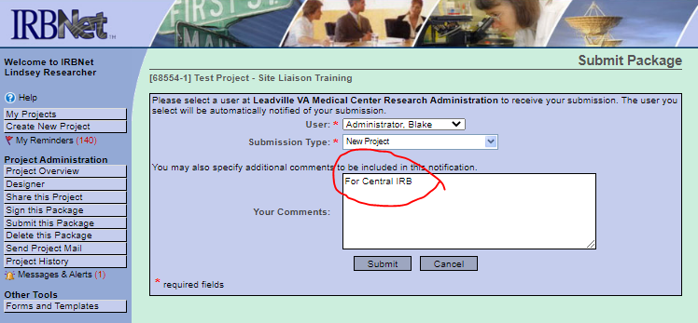
Step 1 – Submission

Slide 11
Step 2 - Notification

Slide 12
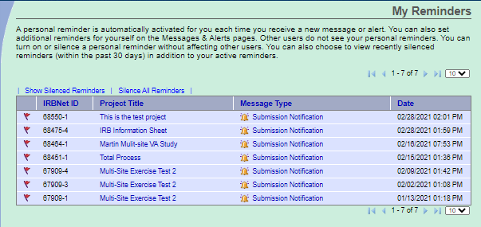
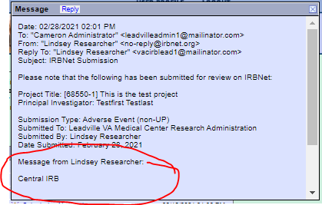
Step 2 - Notification

Slide 13
Step 3 – Administrative Check

Slide 14
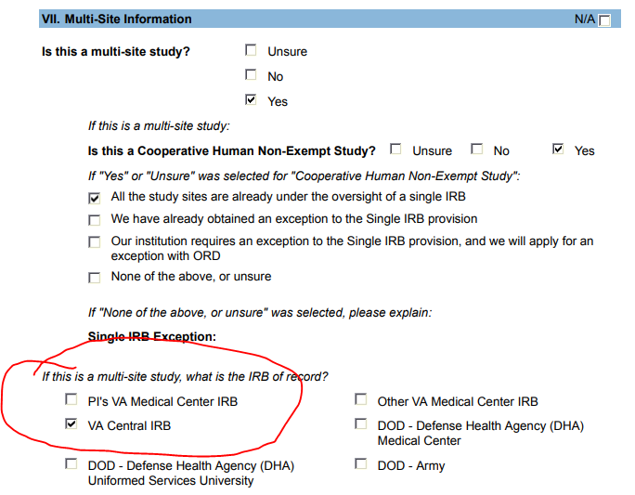
Step 3 – Administrative Check
Project Cover Sheet Wizard submitted with new study submissions – identifies CIRB in Section VII.

Slide 15
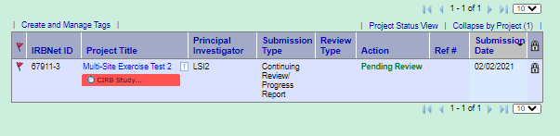
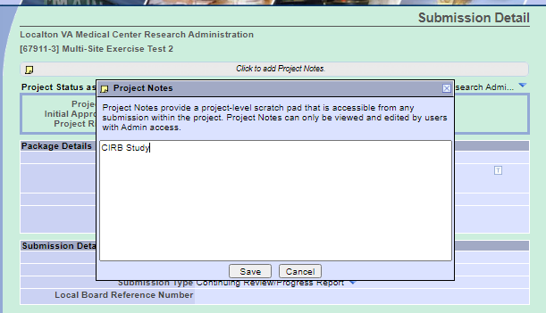
Step 3 – Administrative Check
Project previously tagged (global tag) for CIRB
Project Notes includes comment for CIRB

Slide 16
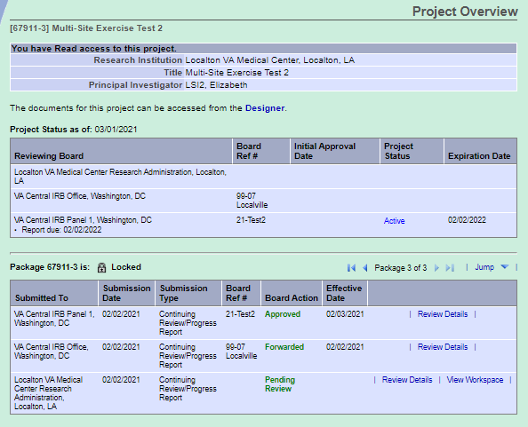
Step 3 – Administrative Check
Project Overview includes details of previous reviews

Slide 17
Step 4: Sharing

Slide 18
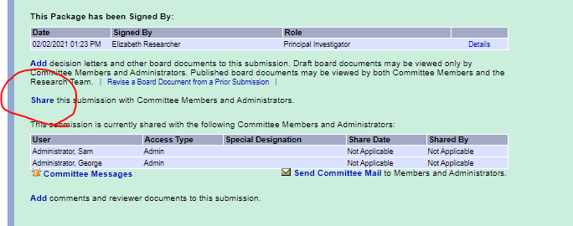
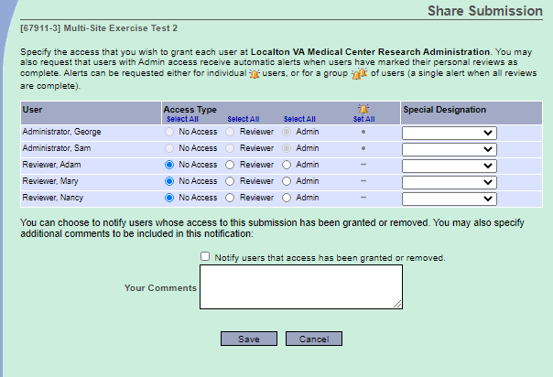
Step 4: Sharing
Select Share link
Select Site Liaison
Select Reviewer Access Type
Select Save

Slide 19
Step 5: Submit to CIRB

Slide 20
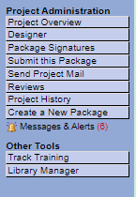
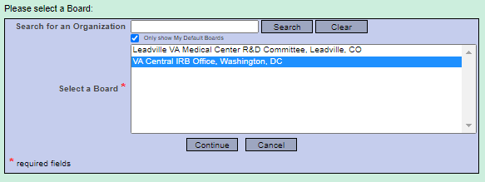
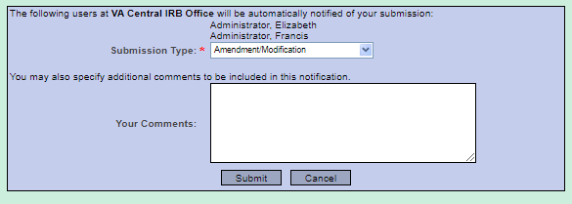
Step 5: Submit to CIRB
Submit this Package
Select VA CIRB
Enter submission type
Select Submit

Slide 21
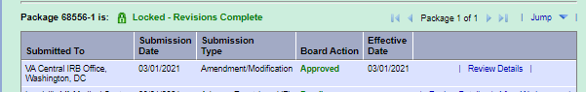
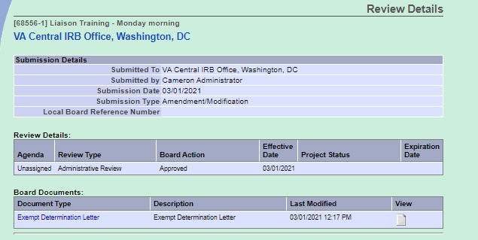
Review Results
The review results may be viewed by selecting Review Details on the
Project Overview page

Slide 22
Step 6: Local Reviews

Slide 23

Demonstration

Slide 24
In Summary …
VA Central IRB submissions begin March 15th
Register for an IRBNet account
Add your appointed VA Central IRB Site Liaison to the roster in your Research Administration workspace

Slide 25
Additional Guidance and Support
VAIRRS SharePoint Portal: https://dvagov.sharepoint.com/sites/VHAORPPE/VAIRRS
VAIRRS Website: https://www.research.va.gov/programs/orppe/vairrs/default.cfm
For questions regarding local submission procedures:
  Contact your local research office
For questions related to CIRB processes:
  Contact the IRB Manager
For questions related to the VAIRRS program:
  Contact Angela Foster at angela.foster@va.gov or VAIRRS@va.gov
For technical issues with IRBNet or to request updates to your roster configuration:
  Contact IRBNet Support at govsupport@irbnet.org

Slide 26
IRBNet Terms
Institution/Organization – Each VAMC and the Central IRB are considered ‘Organizations’ in IRBNet.
Workspace – Each Board or Panel at an Institution has a logical ‘workspace’ to manage submissions to that panel and conduct reviews
Package – Package and submission are used interchangeably. A package represents the individual submissions (Initial Review, CR, Amendments, etc.) for a project.
Submission Manager – The Submission Manager is the primary user interface for all user roles. The submissions viewable in your Submission Manager are dependent on your role, permission level, shared submissions, and selected (manual or default) filters.
IRBNet ID – The IRBNet ID is the unique identifier for every Project and Package. The numbers before the dash represent the Project and the number after the dash represent the package.

Slide 27
VAIRRS Go Live Schedule

Slide 28

Thank You for Attending!

Slide 29
Questions?

Slide 30
Availability of Recording
A recording of this session and the associated handouts will be available on ORPP&E’s Education and Training website approximately one-week post-webinar
An archive of all ORPP&E-hosted webinars can be found here: https://www.research.va.gov/programs/orppe/education/webinars/archives.cfm

